Slide 1
Amazon Employee Performance System
Hamza Salah

Slide 2
Objective
The primary objective of the project was to develop a system capable of analyzing performance to aid the OPS team in tracking and improving employee performance and productivity.

Slide 3
Overview of system
About the system:
This system is an Excel workbook with integrated formulas, macros, and automation features. That refreshes on demand, providing several resources in a single location, and allowing data to be searchable.
It helps managers make instant business decisions using a dashboard showing a variety of metrics and KPIs.

Slide 4
Overview of system
The data generated is used to create employee performance reports.
It is also used to identify areas for improvement, such as training, processes, and technology.

Slide 5
System Creation Process

Slide 6
System Creation Process
1. Identified Stakeholders:
The Ops Team.
Included a total of 10 people and end users.

Slide 7
System Creation Process
2. Created a Statement of Requirements by summarizing user needs.
User Interface:
Dashboard with the ability to customize views and reports based on user roles and preferences.
Performance Analysis:
Automated calculations of performance metrics such as productivity, efficiency, and goal attainment.
Reporting:
The need for specific reports and dashboards to visualize performance trends and identify areas for improvement.

Slide 8
System Creation Process
3. Designed the System:
Designed the structure of the Excel system, including worksheets, and tables,
Design user-friendly interfaces using Excel's features such as buttons, and dropdown lists to streamline data entry and navigation.
Used calculations, formulas, functions, and macros needed to automate processes and perform analysis within the Excel system.

Slide 9
System Creation Process
4. Implementation:
Imported Data into the system.
Automated formulas and macros to perform calculations, and other tasks as per the defined requirements.
Provide training documentation to familiarize users with the Excel system's features and functionalities.

Slide 10
Technical Skills
I employed a range of technical skills and tools including Microsoft Office Tools such as Excel.
I used charts, dashboards, calculations, functions, and lookup methods.
I utilized resources such as Amazon’s internal wiki and learning materials to enhance my understanding and effectiveness in project development.

Slide 11
Project Steps
Identified Metrics that will be used to define the KPIs.
Imported employee CSV data sheets, including only relevant columns.
Cleaned the data using power query
Created sheets that use formulas to LOOKUP imported employee data
Developed formulas for calculations using SUMIFS, AVERAGE, COUNTS, and VLOOKUPS.
Created a dashboard that included metrics.

Slide 12
Data Collection and Preparation
The primary data sources utilized for analysis were CSV files exported from various internal sources relevant to the scope of the project.
In the project, I heavily relied on data importation techniques to transform and clean data within Excel using power query.

Slide 13
Data Cleaning and Preprocessing:
I imported the CSV files directly into Excel worksheets using the "From Text/CSV" option in the "Data" tab.
Upon import, I carefully examined the data in power query to identify any inconsistencies, missing values, or formatting issues.
Using power query, I performed several data cleaning tasks, like removing unnecessary columns.
After cleaning, I formatted data types, and standardized text fields to prepare the data for analysis.

Slide 14
Some challenges with the data
Data needed transformations to be usable in formulas.
No Summarizations included.
Extra Columns.

Slide 15
Employee Analysis

Slide 16
Employee Analysis
Some of the analyses performed include:
Headcount Trends & Forecasts
Employee Rates
Work Details Breakdown

Slide 17
1- Headcount Analysis
Performed headcount analysis and forecasts.
Compared planned headcount with digital and actual headcounts.
The goal was to keep operational costs low in return accomplish more with fewer resources.
Performed forecasting in Excel using linear regression to determine hourly headcount.

Slide 18
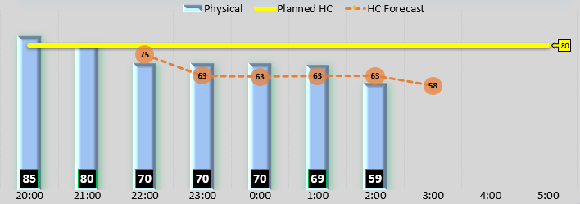
Headcount Hourly Forecasts

Slide 19
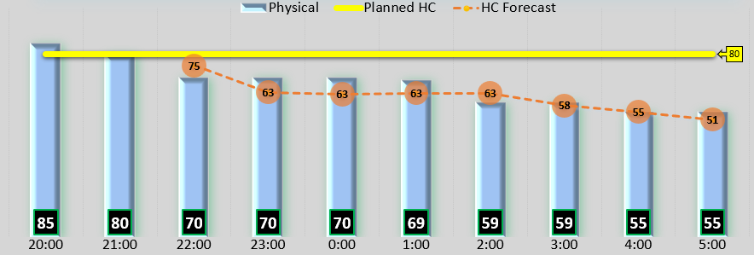
Headcount Hourly Forecasts

Slide 20
2- Employee Rates
Employee Rates were tracked on an individual level and group level.
Lookup functions were used to retrieve AA rates from imported sheets each hour.
I implemented conditional formatting for the highest and lowest average employee rates to automatically showcase the occurrence time.
Use a combination of IF, MIN, and MAX to generate this formula.

Slide 21
Hourly Avg Hourly Rate

Slide 22
Hourly Avg Hourly Rate

Slide 23
3- Work Details
Created a sheet that serves as a comprehensive repository of employee work details. By entering an employee ID, users gain access to the associate's work specifics, which include hourly function time and rates. The sheet dynamically retrieves data from the employee rate sheet based on the provided employee ID, leveraging VLOOKUP functionality.
Showcases the duration spent on different tasks such as small, medium, large, and bulky items, along with the total hours worked per hour. Additionally, it also aids in calculating time on task and time off task in minutes.
A vertically stacked graph is utilized to visually represent the function time.

Slide 24
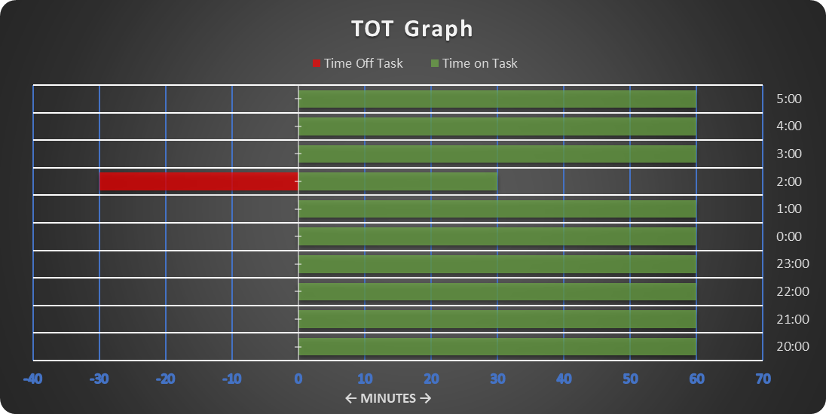
TOT Graph: looking up an employee id

Slide 25
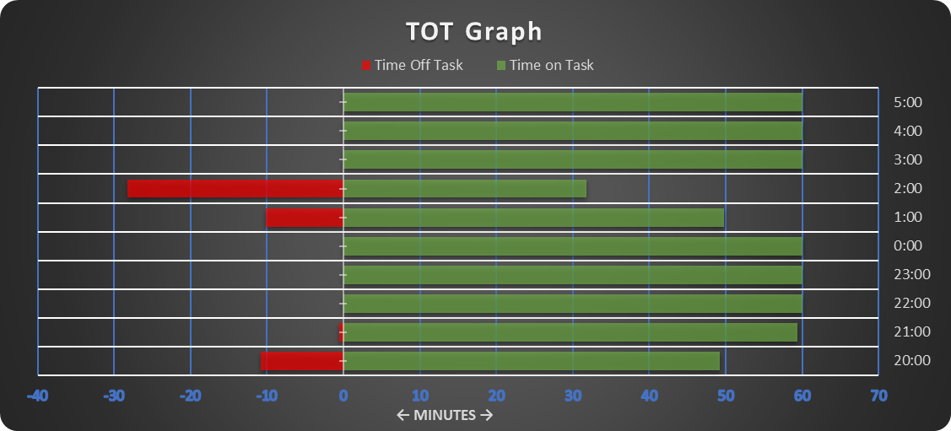
TOT Graph: looking up an employee id

Slide 26
Other Metrics
Work Piles
Successful diverts and forecasts
Number of errors made
Safety Reports
Daily Volume Percentage of Goal Achieved/Remaining

Slide 27
Challenges & Solutions

Slide 28
Challenges & Solutions
Throughout the Project, I encountered several challenges, including:
Performance Issues
Complexity of some charts

Slide 29
Challenges & Solutions
I avoided volatile functions in the system to improve speed.
I utilized Excel's formatting options to Improve the colors of the dashboard to be visually appealing and implemented dynamic filtering options.
Diversified the types of visualizations while keeping them simple and used cards to showcase important metrics.
I added writing to help showcase connections between visuals and or numbers to appeal to less technical individuals.

Slide 30
Purposed Training Initiatives
Collaborated with senior management to provide targeted training for 50 employees using a variety of formats, such as classroom training or on-the-job training.
1- Utilized the employee system to track performance metrics such as items processed, error rates, TOT, and task completion times to identify areas to identify employees who are struggling.
2- Conducted surveys on job satisfaction and training needs to enhance the work environment.
3- Updated and streamlined workflows by creating documentation and problem-solving process techniques to improve work efficiency.

Slide 31
Impact

Slide 32
Impact
The Project had a profound impact on the organization, resulting in improvements in employee performance and decision-making processes.
Through targeted training, we achieved a 10% improvement in sorting efficiency and provided valuable insights for strategic decision-making, ultimately contributing to the organization's success and competitiveness.

Slide 33
Summary
Implementing targeted training initiatives alongside our Excel-based performance tracking system resulted in significant improvements in sorting efficiency and productivity in our 300+ employee department. This led to a 10% performance increase and the processing of over 262,000 items.

Slide 34
Evaluation
The system went through Iterations and Improvements that included different colors for visibility, and the addition of different metrics like safety reports.

